Slide 1
CPS 235 Object Oriented Programming Paradigm
Lecturer Aisha Khalid Khan
Inheritance

Slide 2
Contents
Composition (or containership)
  Objects as Members of Classes
Concept of Inheritance
Levels of access control
CPS235:Inheritance

Slide 3
Composition vs Inheritance
Composition – A “has a” relationship
  An employee has a name, id, salary
  Class member data can contain basic data types as well as objects of other classes
  An employee has a date of birth and date of hiring and these can be represented by objects of a date class
Inheritance – A “kind of” or “is a” relationship
  An employee can be a laborer, a scientist, a manager, an engineer
  These are all examples of a more general category of employees
  So a laborer is an employee, so is a scientist and so on…
CPS235:Inheritance

Slide 4
Composition/Containership
Objects as members of a class
CPS235:Inheritance

Slide 5
date1.h (1 of 1)
#include <iostream>
#include<conio>
7 class Date {
8
9 public:
10 Date( int = 1, int = 1, int = 1900 ); // default constructor
11 void print() const; // print date in month/day/year format
~Date(); // provided to confirm destruction order
Date (const Date& d); //copy constructor
13
14 private:
15 int month; // 1-12 (January-December)
16 int day; // 1-31 based on month
17 int year; // any year
18
22 }; // end class Date

Slide 6
date1.cpp (1 of 3)
11 Date::Date( int mn, int dy, int yr )
14 {
15 if ( mn > 0 && mn <= 12 ) // validate the month
16 month = mn;
17
18 else { // invalid month set to 1
19 month = 1;
20 cout << "Month " << mn << " invalid. Set to month 1.\n";
21 }
22
23 year = yr; // should validate yr
day = dy;
// output Date object to show when its constructor is called
27 cout << "Date object constructor for date ";
28 print();
29 cout << endl;
30
} // end Date constructor
void Date::print() const
35 {
36 cout << month << '/' << day << '/' << year;
37
38 } // end function print
39
40 // output Date object to show when its destructor is called
41 Date::~Date()
42 {
43 cout << "Date object destructor for date ";
44 print();
cout << endl;
getch();
46
47 } // end destructor ~Date

Slide 7
date1.cpp (2 of 3)
//Copy constructor
Date::Date(const Date& d)
{
month = d.month;
day = d.day;
year = d.year;
cout<<“copy constructor for date object";
print();
cout<<endl;
}

Slide 8
employee1.h (1 of 2)
class Employee {
11 public:
13 Employee(
14 const char [], const char [], const Date &, const Date & );
15 void print() const;
17 ~Employee(); // provided to confirm destruction order
18
19 private:
20 char firstName[ 25 ];
21 char lastName[ 25 ];
22 const Date birthDate; // composition: member object
23 const Date hireDate; // composition: member object
24
25 }; // end class Employee

Slide 9
employee1.cpp
(2 of 3)
13 // constructor uses member initializer list to pass initializer
14 // values to constructors of member objects birthDate and
// hireDate [Note: This invokes the "default copy constructor“]
17 Employee::Employee( const char first[], const char last[],
18 const Date &dateOfBirth, const Date &dateOfHire )
19 : birthDate( dateOfBirth ), // initialize birthDate
20 hireDate( dateOfHire ) // initialize hireDate
21 {
22 // copy first into firstName and be sure that it fits
23 int length = strlen( first );
24 length = ( length < 25 ? length : 24 );
25 strncpy( firstName, first, length );
26 firstName[ length ] = '\0';
27
28 // copy last into lastName and be sure that it fits
29 length = strlen( last );
30 length = ( length < 25 ? length : 24 );
31 strncpy( lastName, last, length );
32 lastName[ length ] = '\0';
33
34 // output Employee object to show when constructor is called
35 cout << "Employee object constructor: "
36 << firstName << ' ' << lastName << endl; }
Member initializer syntax to initialize Date data members birthDate and hireDate; compiler uses the copy constructor of Date class
Output to show timing of constructors.

Slide 10
employee1.cpp
(3 of 3)
40 // print Employee object
41 void Employee::print() const
42 {
43 cout << lastName << ", " << firstName << "\nHired: ";
44 hireDate.print();
45 cout << " Birth date: ";
46 birthDate.print();
47 cout << endl;
48
49 } // end function print
50
51 // output Employee object to show when its destructor is called
52 Employee::~Employee()
53 {
54 cout << "Employee object destructor: "
<< lastName << ", " << firstName << endl;
getch();
56
57 } // end destructor ~Employee
Output to show timing of destructors.

Slide 11
fig07_10.cpp
(1 of 1)
#include <iostream>
10 int main()
11 {
12 Date birth( 7, 24, 1949 );
13 Date hire( 3, 12, 1988 );
14 Employee manager( "Bob", "Jones", birth, hire );
getch();
15
16 cout << '\n';
manager.print();
cout<<‘\n’;
Employee clone(“Rob”, “Jones”, birth, hire);
cout<<‘\n’;
clone.print();
getch();
23 return 0;
24
25 } // end main
Create Date objects to pass to Employee constructor.

Slide 12
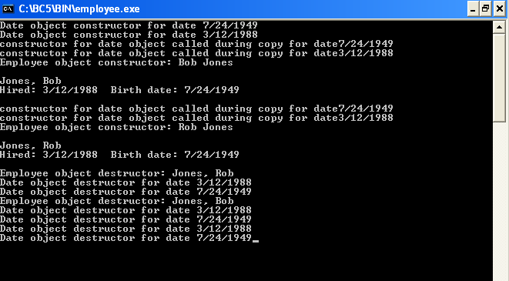
Output
Note two additional Date objects constructed; copy constructor used
Destructor for host object manager runs before destructors for member objects hireDate and birthDate.
Destructor for Employee’s member object hireDate.
Destructor for Employee‘s member object birthDate.
Destructor for Date object hire.
Destructor for Date object birth.
CPS235:Inheritance

Slide 13
Compulsory Reading
Deitel and Deitel (5th edition)
  Topic: 10.3. Composition: Objects as Members of Classes
CPS235:Inheritance

